Slide 1
eXtensible Stylesheet Language (XSL)
Processing XML
(mainly based on IBM course XM341)
Software Institute, Nanjing University
Bei Jia

Slide 2
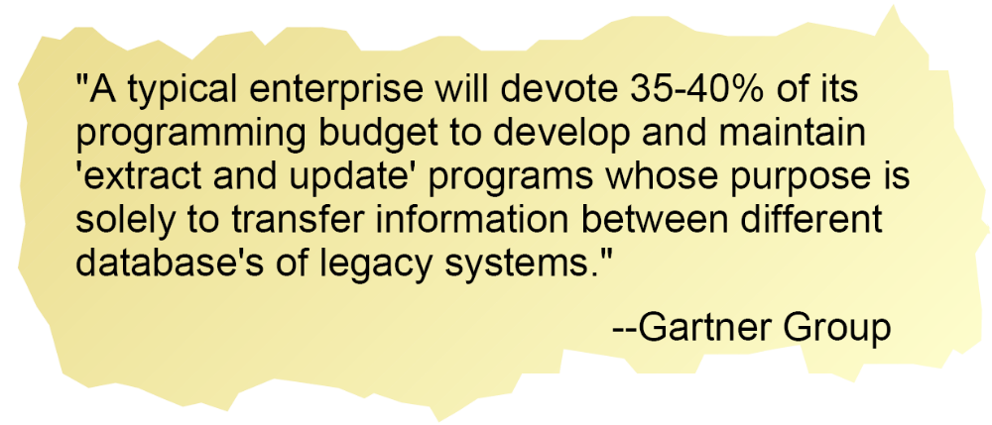
Why Do We Need XSL? (1/2)
2

Slide 3
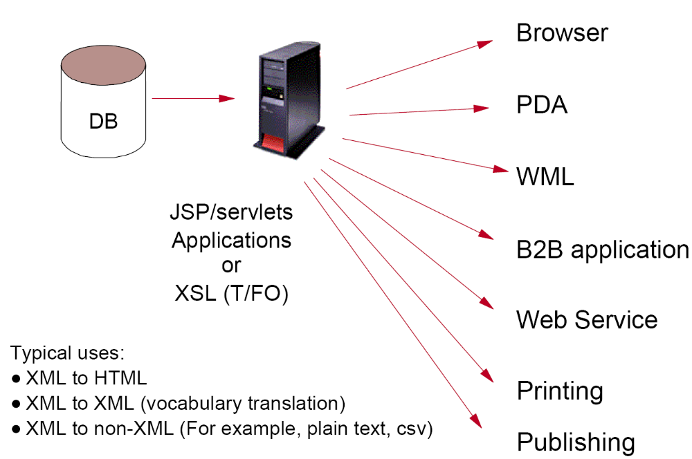
Why Do We Need XSL? (2/2)

Slide 4
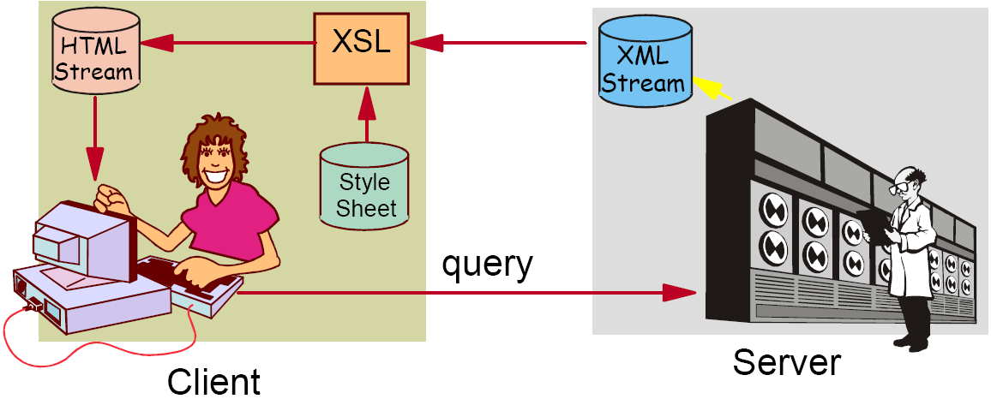
XSL Is at Home on the Client

Slide 5
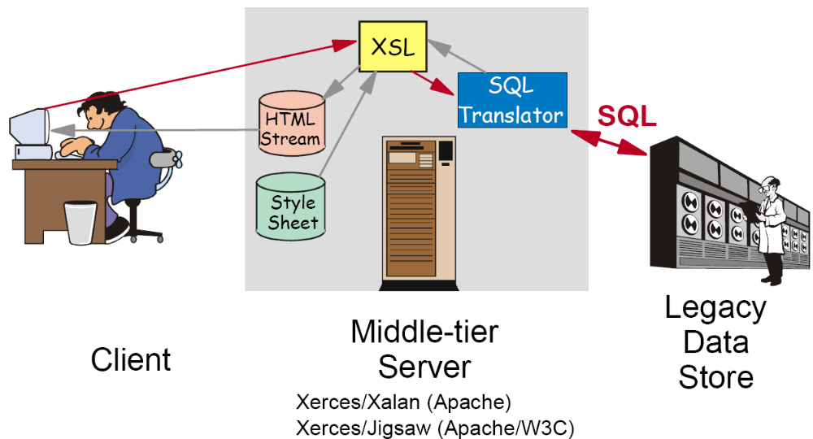
XSL Is at Work on the Server

Slide 6
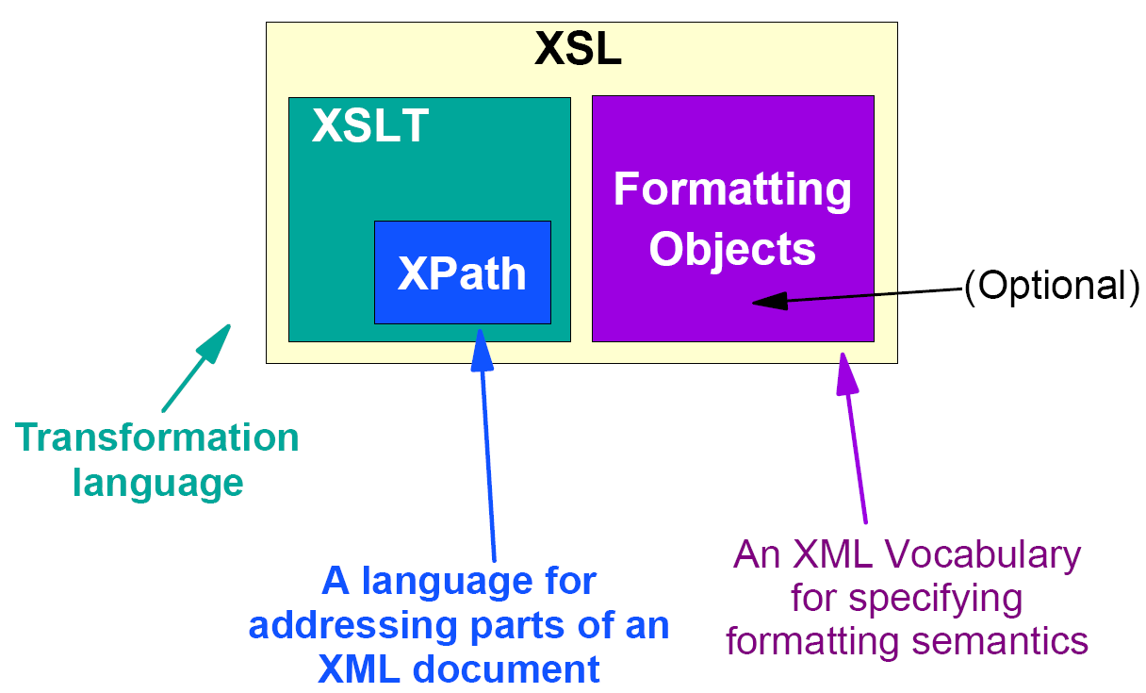
XSL: Three Parts

Slide 7
What Is XPath?
W3C Recommendation (Nov. 16, 1999) for querying an XML document
  Does not have an implementation independent of other standards/technologies.
  Used by XSLT, XPointer, XQuery and so on
Often when processing XML, we need to address (locate) a portion of or elements of the document which meet specified criteria
  e.g., In XML for a book on Java, find the chapters with JDBC in the title
Provides the ability to address any slice of an XML document in any direction
  Either forwards, backwards or sideways

Slide 8
Why Is It Called XPath?
Consider the DOS, UNIX, or URI syntax for addressing files in a directory structure
  /publications/articles/Transformations.xml
  This is called a pathname to the file
  It describes the path to follow, from the root, through a tree of directories (folders), to locate a given file
XML documents are frequently viewed as a tree of nodes. Expressions describe a path to a given node or set of nodes
Similarly, XPath also uses a forward slash to separate the nodes of a path

Slide 9
XSLT
XSLT (Extensible Stylesheet Language Transformations) is a language for transforming XML documents into other XML documents, or other formats such as:
  HTML for web pages
  Plain text
  XSL Formatting Objects, which may subsequently be converted to other formats, such as PDF PostScript and PNG
The original document is not changed; rather, a new document is created based on the content of an existing one
Typically, input documents are XML files, but anything from which the processor can build an XQuery and XPath Data Model can be used, for example relational database tables, or geographical information systems
XSLT is a Turing-complete language, meaning it can specify any computation that can be performed by a computer

Slide 10
XSLT Language Characteristics (1/2)
Uses XML Syntax
No side-effects (Parts of a stylesheet can be processed in any order and independently) :
  When functions have side-effects, they must be executed in a specific order
  Means you cannot update the value of a variable
Pattern-matching rule based/declarative:
  A stylesheet is a sequence of template rules each of which says how a particular node should be processed
  No ordering is needed for the template rules
  These rules make XSLT declarative - you declare what you want done to the XML nodes
  XSLT relies on XPath for a large part of its pattern matching functionality

Slide 11
XSLT Language Characteristics (2/2)
Closure (the output has the same data structure as the input):
  For XSLT, this structure is the tree representation of XML. The input is XML and the output is a tree which is built as the input nodes are processed
  Means you can combine operations in a pipe-like structure where the output of one operation is the input for another
Recursive:
  XSLT supports recursion with built-in constructs

